Slide 1
Project 5:
Generative Adversarial Network
Zhifei Zhang

Slide 2
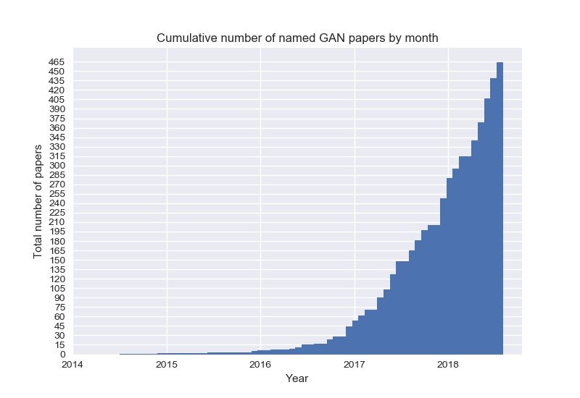
Generative Adversarial Network (GAN)
https://github.com/hindupuravinash/the-gan-zoo

Slide 3

Generative Adversarial Network (GAN)

Slide 4
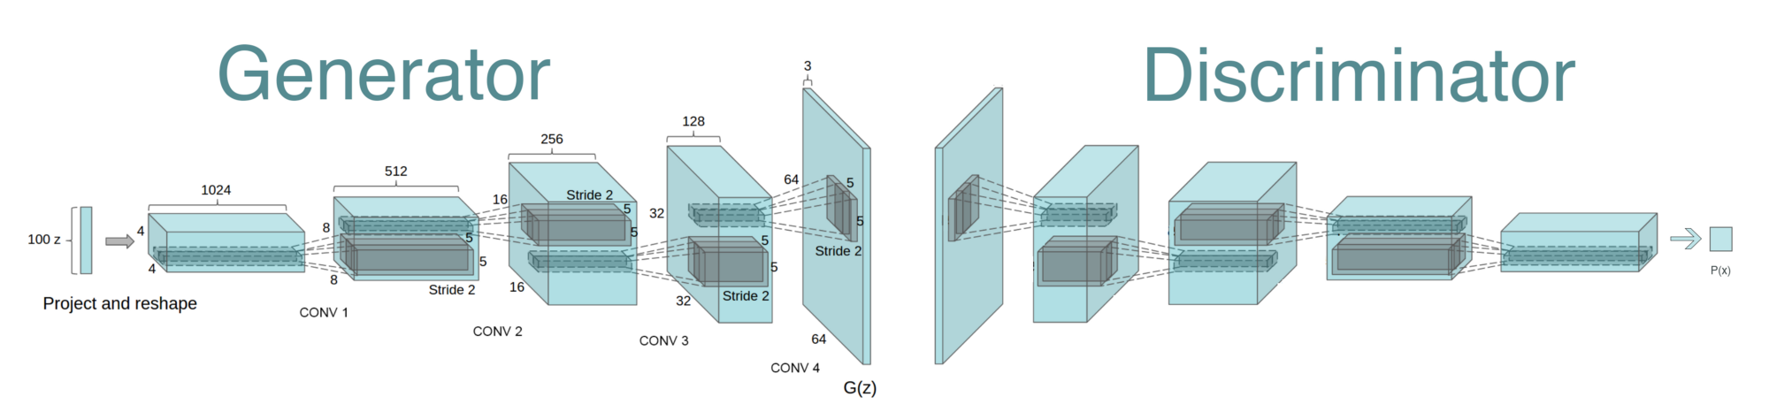
Generative Adversarial Network (GAN)
Binary Classifier:
Conv, Leaky ReLU,
FC, Sigmoid
New components:
Transposed convolution,
Batch Normalization
https://github.com/PramodShenoy/GANerations

Slide 5
Transposed Convolution (Deconvolution)
Stride=1
Pad=Valid
Stride=2
Pad=Valid
Stride=2
Pad=Same
Output
Conv
Input
Output
Deconv
Input
https://github.com/vdumoulin/conv_arithmetic

Slide 6
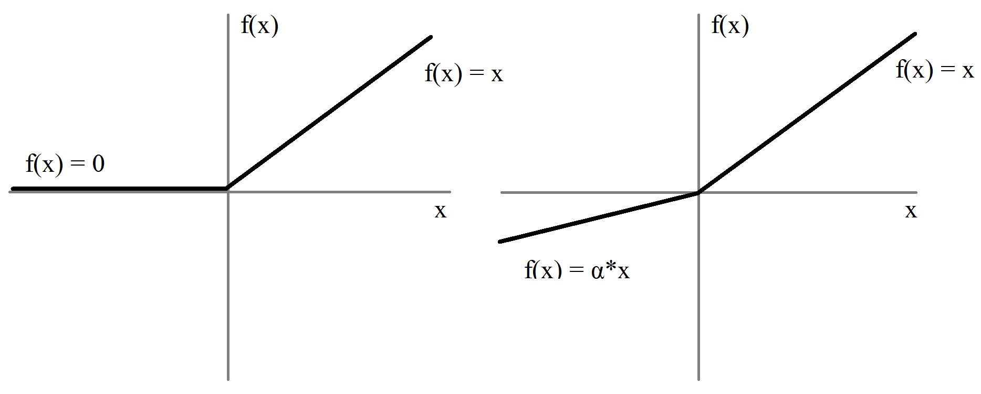
ReLU vs. Leaky ReLU (LReLU)
Used in Generator
Used in Discriminator

Slide 7
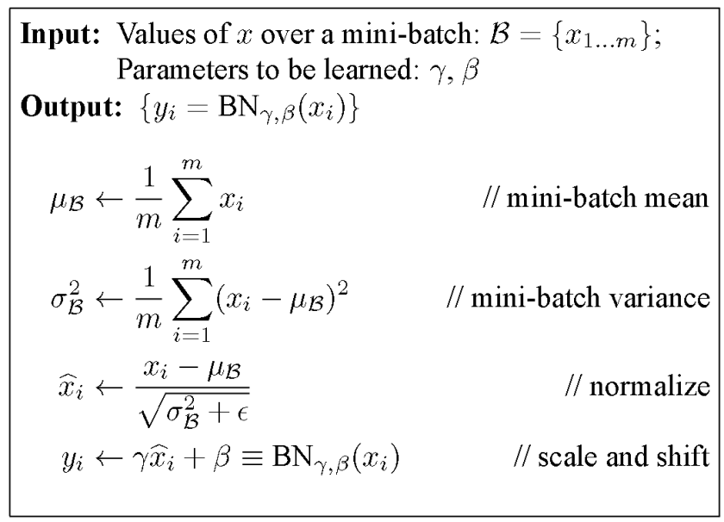
Batch Normalization (BN)
Saturation area
Zero gradient
https://towardsdatascience.com/batch-normalization-in-neural-networks-1ac91516821c

Slide 8
Generative Adversarial Network (GAN)
Reshape,
FC, sigmoid
FC, BN, ReLU
Reshape
Conv (kernel 5x5, stride 2)
BN, LReLU (slope 0.2)
Deconv, tanh/sigmoid
Deconv (kernel 5x5, stride 2)
BN, ReLU
https://github.com/PramodShenoy/GANerations

Slide 9
GAN on MNIST
Deconv
Tanh/Sigmoid
Conv, BN,
LReLU
Conv, BN,
LReLU
Reshape,
FC, BN,
LReLU
FC,
Sigmoid
FC, BN,
Reshape
Deconv
BN, ReLU
100
7x7x16
14x14x8
28x28x1
14x14x8
7x7x16
256
1
Generator
Discriminator

Slide 10
Conditional GAN on MNIST
One-hot label
Deconv
Tanh/Sigmoid
Conv, BN,
ReLU
Conv, BN,
ReLU
Reshape,
FC, BN,
ReLU
FC,
Sigmoid
FC, BN,
Reshape
Deconv
BN, ReLU
100
7x7x16
14x14x8
28x28x1
14x14x8
7x7x16
256
1
Generator
Discriminator

Slide 11
TensorFlow Implementation of GAN
Run the demo code: (Linux or MacOS)
$ git clone https://github.com/carpedm20/DCGAN-tensorflow
$ cd DCGAN-tensorflow
$ pip install tqdm (if you do not have this package)
$ python download.py mnist
$ python main.py --dataset mnist --input_height=28 --output_height=28 --train

Slide 12
TensorFlow Implementation of GAN
Input: z, image, (label)
Network: D, G
Loss: D, G
Optimizer: D, G
Training:
for epoch
for batch
Update D
Update G

Slide 13
https://devblogs.nvidia.com/photo-editing-generative-adversarial-networks-1/

Slide 14
TensorFlow Implementation of GAN
Testing:
Random Generation
Conditional Generation
Interpolation

